Slide 1

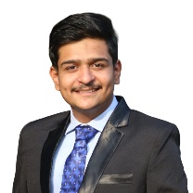

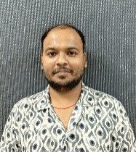
CT Image Denoising
PID_1544
Jeet Nakrani
Mayank Kathane
Shubham Vishwakarma
College Name - Mukesh Patel School of Technology, Management and Engineering (NMIMS), Mumbai

Slide 2
Challenge Statement
Understanding the Problem
In medical imaging, particularly brain CT scans, image quality is often compromised by two prevalent types of noise:
Poisson Noise:
Originates from the statistical nature of photon detection during image acquisition.
Periodic Noise:
Caused by interference from electronic and mechanical components in the CT scanner.
Challenge Requirement
The objective is to develop a software tool capable of:
Reading and displaying CT brain scans in DICOM format.
Designing an algorithm that reduces Poisson and periodic noise effectively.
Enhancing image clarity while preserving essential diagnostic information, leading to more accurate diagnoses.
1544

Slide 3

Concept / Scope of solution
Autoencoder Architecture: Our denoising autoencoder not only removes noise from CT scans but also preserves essential image details, making diagnosis clearer and more reliable.
DICOM Integration: The model works directly with DICOM files, ensuring that all critical medical data remains intact throughout the process.
Medical Diagnostics: By enhancing CT scan clarity, this solution improves the detection of conditions like tumors, hemorrhages, and structural anomalies.
Scalable & Versatile: This approach can be extended to other medical imaging techniques like MRI or even integrated into real-time CT workflows.
Glioma Tumour
Meningioma Tumour
No Tumour
Pituitary Tumour
Dataset contains 4 classes
Dataset
1544

Slide 4
Feedback from Presentation Round and its Use
GUI – User-Friendly: Implemented an intuitive interface for easy navigation and better user engagement
Minimal Loss in CT Scan Images: Ensured high-quality image handling through optimized compression and error-free data processing
Deployment: Streamlined solution deployment across multiple platforms, enabling wider accessibility
Multiple Images Upload: Added batch upload functionality for handling multiple images simultaneously
Download Option: Provided a direct download feature for results, enabling offline review and further analysis
1544

Slide 5

SWOT Analysis
STRENGTH
WEAKNESS
High-quality noise reduction (Poisson & periodic noise)
DICOM compatibility for seamless integration
Automated & efficient – reduces manual intervention
Scalable – adaptable to MRI, ultrasound, etc.
High computational demand (requires GPUs)
Data dependency – needs large, high-quality datasets
Potential artifacts – risk of altering critical medical details
OPPORTUNITIES
THREATS
Integration with PACS (Picture Archiving and Communication System) & hospitals
Real-time processing with optimized models
Expansion to other medical imaging modalities
Regulatory & ethical concerns (HIPAA, GDPR)
Resistance to AI adoption by radiologists
Competitor AI-based solutions in medical imaging
1544

Slide 6
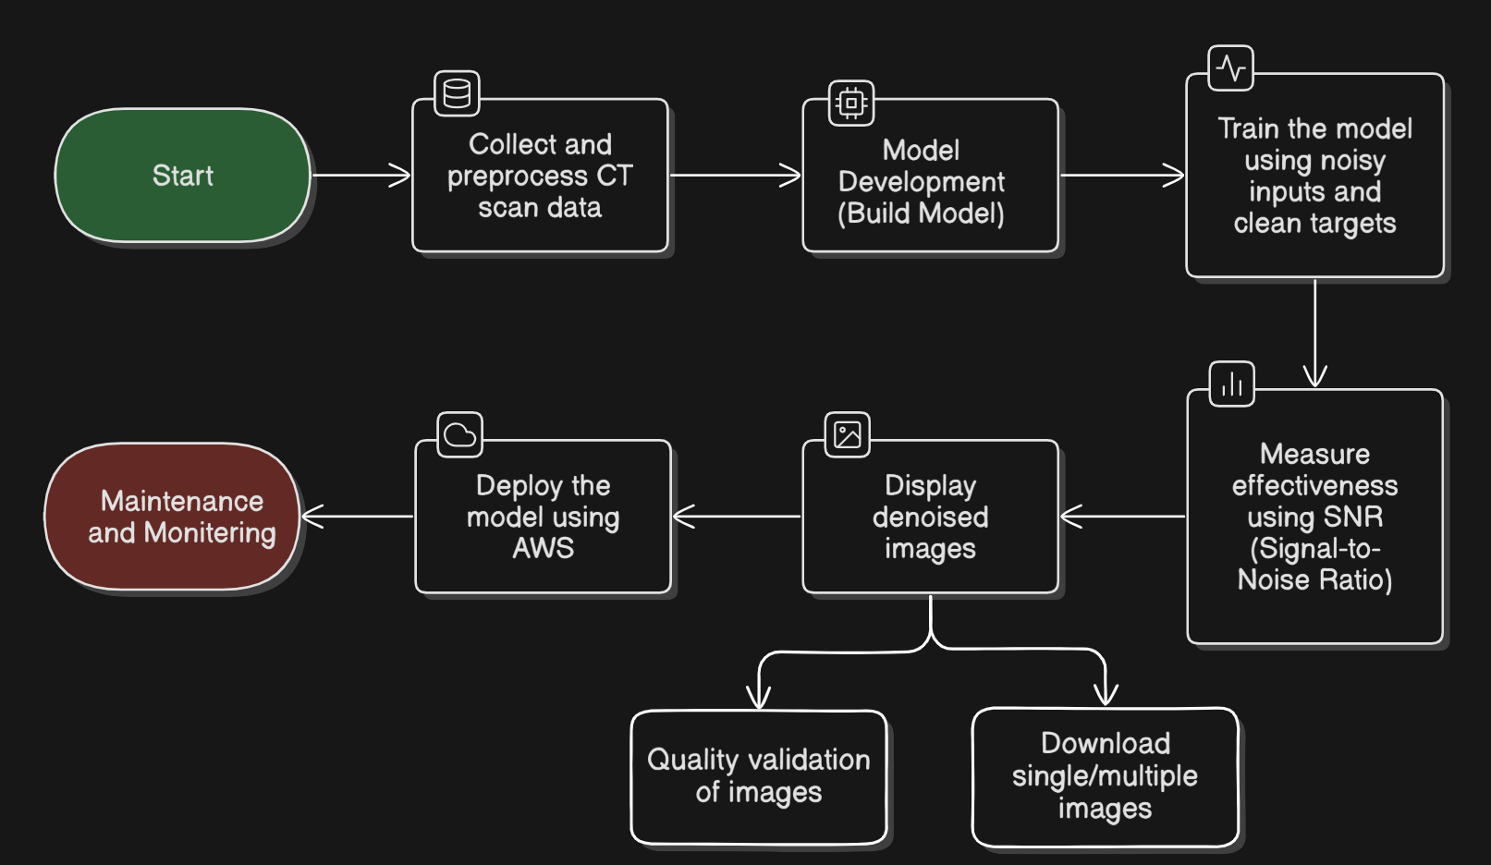
Implementation (1/2)
1544

Slide 7
Implementation (2/2)
Conv2D (Encoder)
Conv2D (Encoder)
Conv2D (Decoder)
UpSampling2D
Conv2D (Decoder)
Conv2D (Output)
MaxPooling2D
Encoder
Decoder
Extracts low-level features
Reduces spatial dimensions while retaining essential features
Bottleneck Compression
Reconstruction Phase
Upscaling
Enhancement
Final Denoised Image
1544

Slide 8
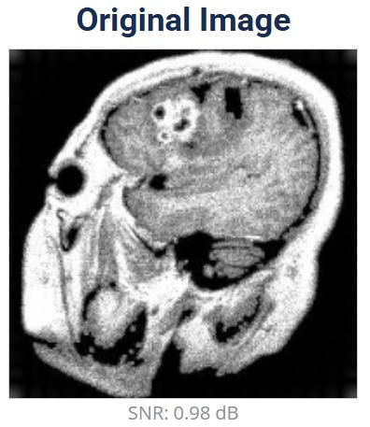
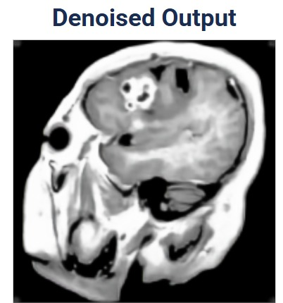
Testing / Analysis (1/2)
SNR: 0.98 dB
SNR: 18.91 dB
SNR Improvement: Increased from 0.98 dB (original) to 18.91 dB, enhancing image quality
1544

Slide 9
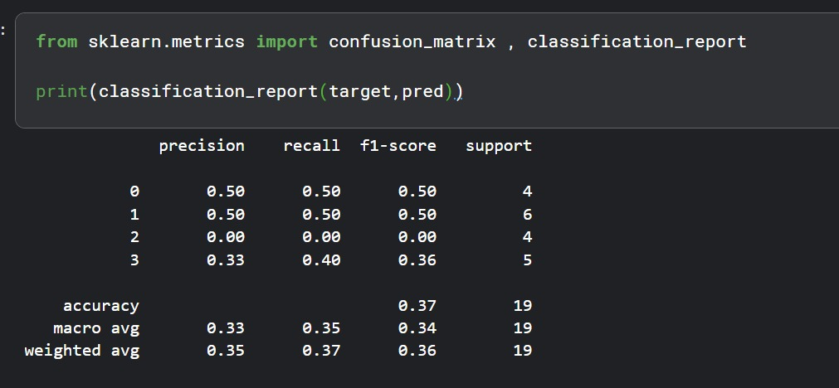
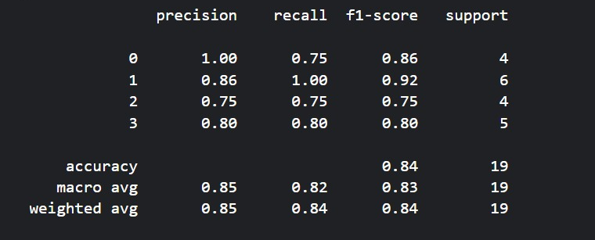
Testing / Analysis (2/2)
Noisy Image
Denoised Image
Denoising Evaluation: Processed 19 noisy CT scan images through the model, resulting in increased SNR, indicating improved image quality.
Disease Prediction Validation: Developed a separate classification model to predict disease presence and type using both noisy and denoised images.
Performance Comparison: Generated a classification report comparing model accuracy on noisy vs. denoised images.
Key Insight: The model extracts features more effectively from denoised images, leading to better classification accuracy and improved disease prediction.
1544

Slide 10
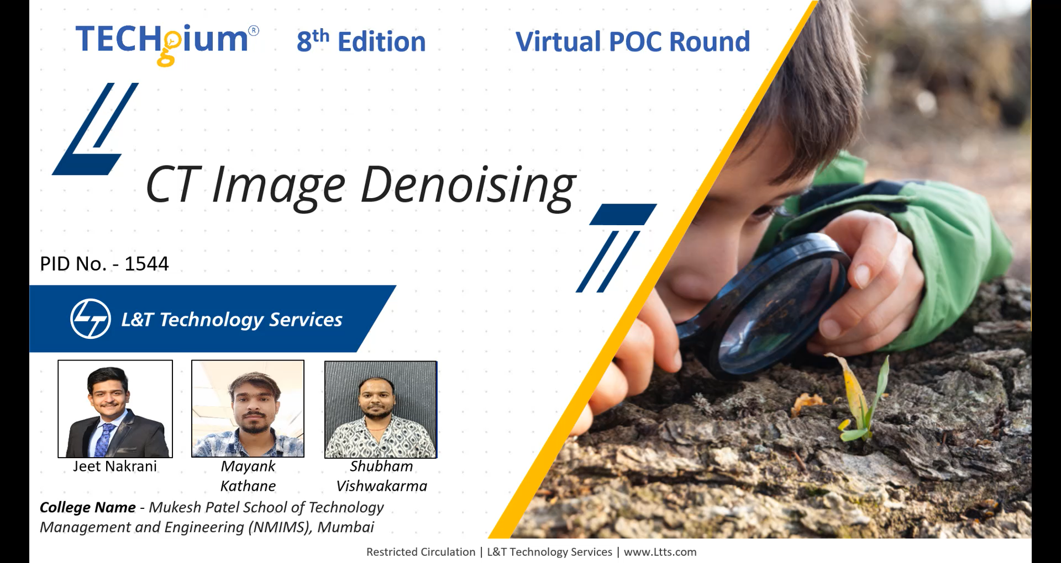
POC Demo
1544
Video Link

Slide 11
High Level plan for converting POC to MVP
Aspect | POC | MVP | Upgrades / Actions
Algorithm & Model | Basic autoencoder with minimal tuning on a small dataset. | Enhanced model robustness and improvements (e.g., real-time denoising, additional features). | Scale training with diverse data. Explore alternate architectures and refine loss functions.
Data Handling | Limited DICOM integration and curated dataset. | Automated data pipelines handling larger, diverse datasets with augmented data and integrated PACS connectivity. | Implement automated preprocessing and labeling. Ensure data quality and compliance checks.
User Interface | Minimal UI/CLI for demonstration purposes. | Full-fledged, intuitive GUI integrated into clinical workflows with functionalities such as batch uploads, visualization, and download options. | Develop a user-friendly interface. Integrate with existing hospital systems.
Infrastructure | Limited cloud/GPU resources; manual deployment. | Scalable, automated cloud or on-premises HPC deployment with CI/CD pipelines and real-time monitoring. | Upgrade compute resources. Automate deployment and monitoring for continuous improvement.
Compliance & Security | Basic anonymization and internal protocols. | Robust regulatory compliance (e.g., HIPAA/GDPR) with enhanced data security measures, audits, and documentation. | Engage in security audits. Formalize compliance processes and documentation.
Testing & Validation | Preliminary tests with manual validation. | Comprehensive testing including performance evaluation, user acceptance, and clinical validation. | Expand test cases and validation protocols. Gather structured feedback from clinical users.
1544

Slide 12
Cost for POC vs MVP
Cost Category | PoC (₹) | MVP (₹) | Description
Data Collection | NA | 20,000+ | Costs for obtaining and preprocessing CT scan datasets.
Computational Resources | NA | 30,000 - 50,000 | Cloud GPU usage, servers, and storage for training and validation.
Testing & Validation | NA | 15,000 - 25,000 | Costs associated with evaluating model performance (SNR calculation, validation).
Deployment & Maintenance | ~ 1,500 - 2,000 | 40,000 - 1,00,000+ | Deployment on servers, maintenance, and updates.
Personnel | NA (self/research) | 1,50,000+ per month | Salaries for data scientists, engineers, and developers involved in the project.
Note: -
The above cost estimate is approximate and may vary based on project scope, resource availability, and specific requirements.
Total POC Estimated Cost: ₹1,500 - ₹2,000
Total MVP Estimated Cost: ~ ₹2,50,000+
1544

Slide 13




Result / Conclusion
Significant Noise Reduction & SNR Improvement:
The model effectively reduced Poisson and periodic noise while preserving critical medical details, enhancing the Signal-to-Noise Ratio (SNR) for superior image quality.
Disease Prediction Enhancement:
A classification model demonstrated improved feature extraction and disease prediction accuracy using denoised images.
User-Friendly Solution:
Integrated a GUI with batch image upload and download options for easy usability.
Potential for Expansion:
The solution can be adapted to other medical imaging modalities (e.g., MRI) and real-time CT workflows.
1544

Slide 14
References
List of research papers or articles on CT image denoising, Autoencoders, and related deep learning techniques.
Larrue, Tara, etal.”Denoising Videos with Convolutional Autoencoders.”(2018).
Xie, Junyuan,LinliXu, and EnhongChen. ”Image denoising and in painting with deep neural networks.” Advances in neural information processing systems. 2012.
Dabov, Kostad in , etal. ”BM 3D image denoising with shape-adaptive principal component analysis.”SPARS’09-Signal Processing with Adaptive Sparse Structured Representations.2009.
Image Denoising based on Deep Learning – Zeyu Li https://drive.google.com/file/d/1sJKonZFW6PhQg4-AKRriazfPnhD1v_m3/view
Brief review of image denoising techniques - Linwei Fan1,2,3, Fan Zhang2,Hui Fan2 and Caiming Zhang1,2,3 - https://drive.google.com/file/d/1TA43lQucTmFZyyxK1AGY5-3-pwXDB7yq/view
Reference to any medical imaging databases used (e.g., Kaggle).
TensorFlow/Keras Documentation for model implementation.
Dataset
1544

Slide 15

THANK YOU

